Slide 1
Improvement of Energy Efficiency with a new power source allocation scheme based on non-linear Energy Harvesting model
Yanbo Liu
Background of the project
Methodology
Results and Evaluation
Future Improvement

Slide 2
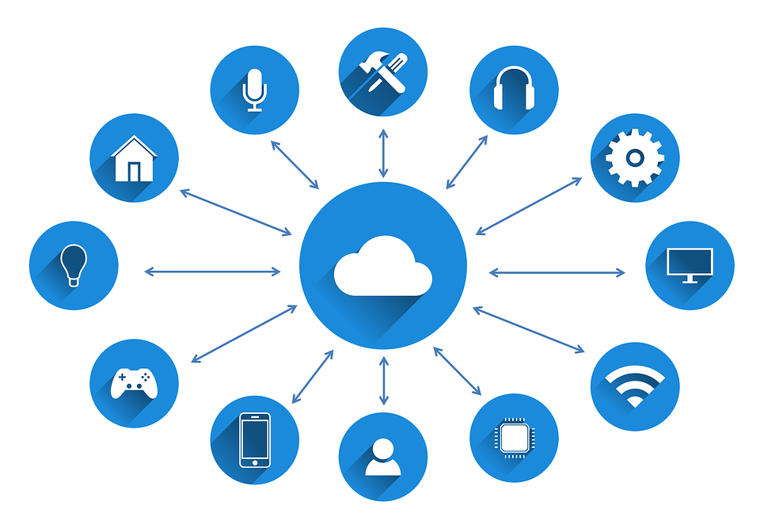
IOT

Slide 3
Benefit from IOT
1. Improved productivity of staff and reduced human labour
2. Better use of resources and assets
3. improved customer service and retention

Slide 4
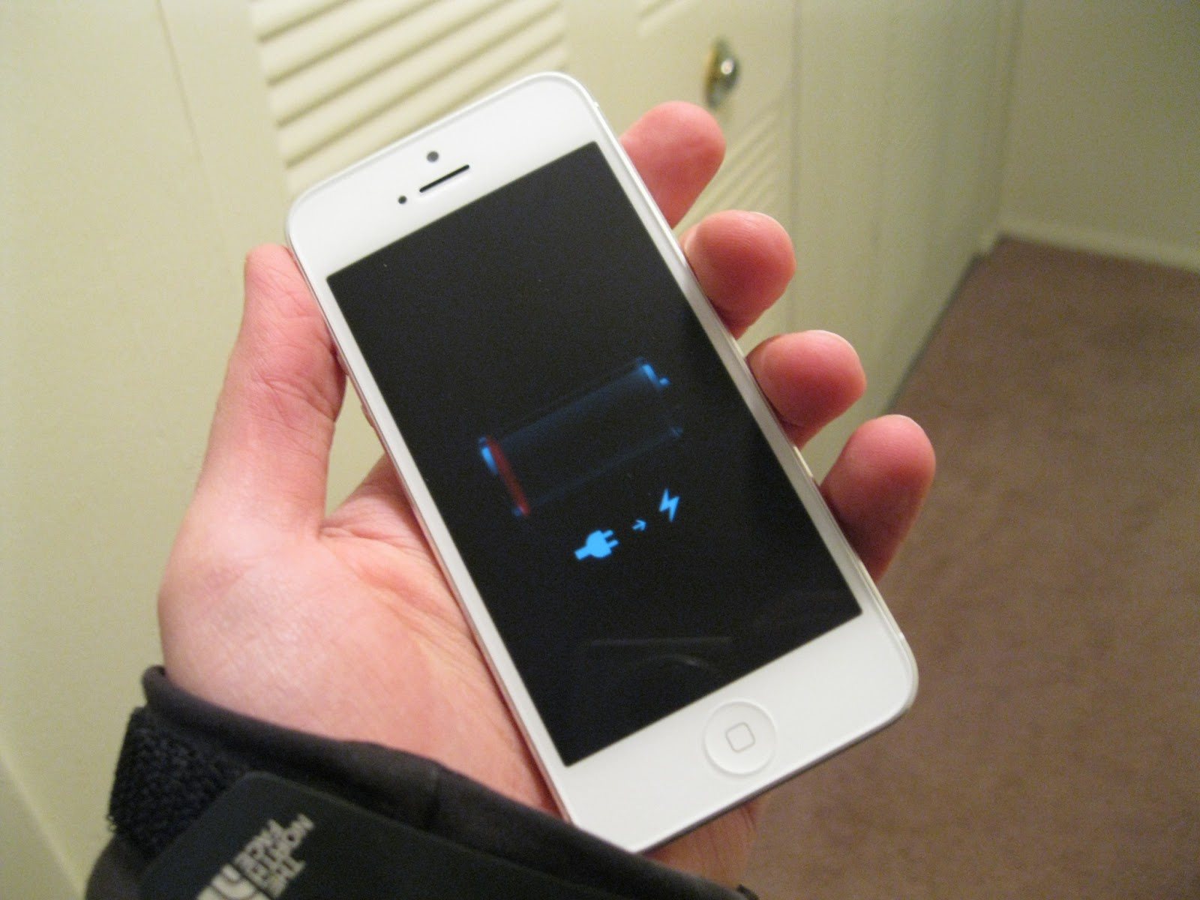
Problem of IOT: Low Energy Efficiency
Caused by
1.Limited built-in battery lifetime
This Photo by Unknown Author is licensed under CC BY-NC

Slide 5
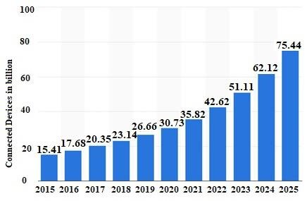
There will be over 75 billion connected devices in IOT Network by 2025 ..

Slide 6

Is it possible for mobile devices to charge themselves?

Slide 7
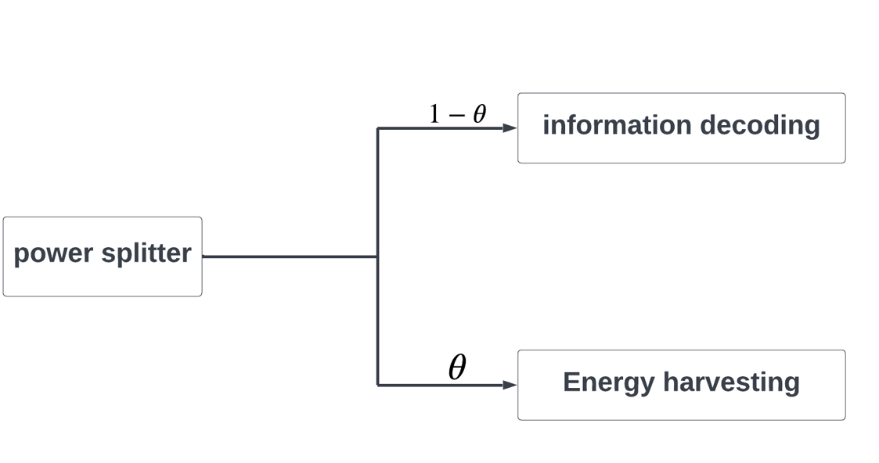
Fortunately, we have SWIPT!!!

Slide 8
Simultaneous Wireless Information and power transfer (SWIPT)
1.It allows the mobile devices to harvest energy from ambient environment to charge the built-in batteries
2.It can exploit the useless mutual interference power for the IOT system.

Slide 9
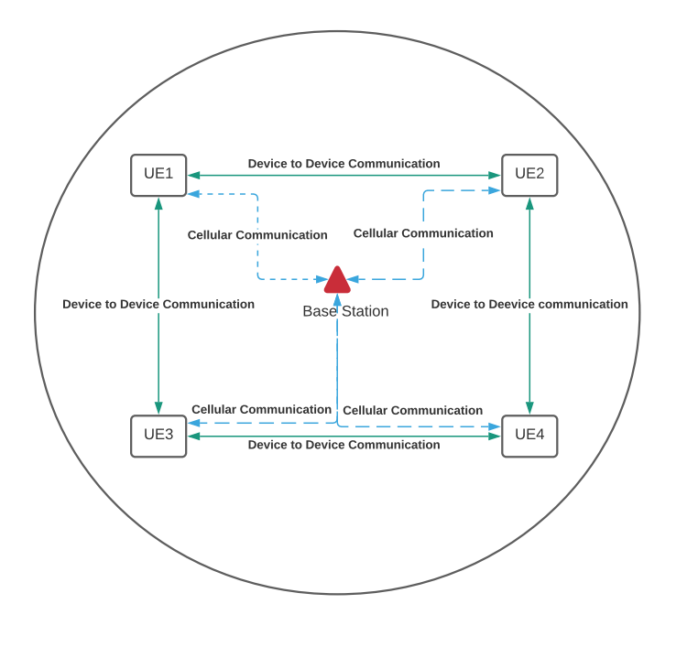
Device-to-Device communication system(D2D)
1.It allows two users in proximity to communicate with each other directly without passing through the base station by reusing the spectrum resource

Slide 10
SWIPT-Supported D2D links
Cellular User Equipment (CUE)

Slide 11


But, it is impossible that all the D2D links can perform SWIPT....
Because of
1.Channel Condition
2.Throughput requirement
Is there a method we can use to find those D2D links that can perform SWIPT?

Slide 12
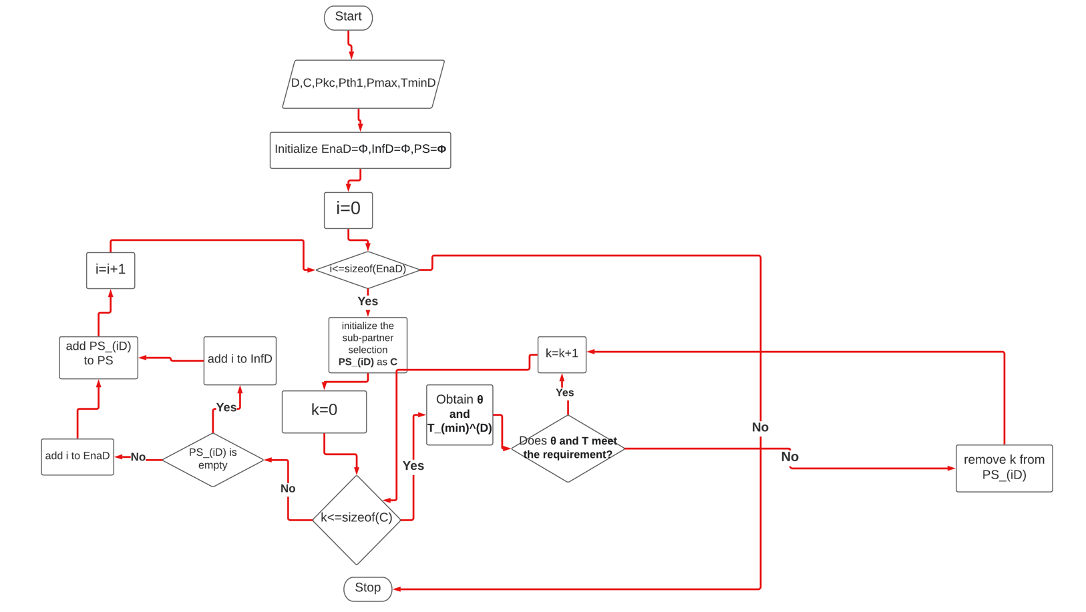
Pre-Matching

Slide 13

Throughput and Power splitting ratio requirement [1]
$θ_{i,min}=\frac{P_{thresold}^{1}}{P_{max}h_{i}^{D}+P_{k}^{c}h_{k,i}+N_{0}}$
$T_{i}^{D}=\frac{P_{i}^{D}h_{i}^{D}}{P_{k}^{C}h_{k,i}+N_{0}+\frac{N_{1}}{1−θ_{i,min}}}$

Slide 14
After using Pre-Matching.....
The Entire D2D group
EnaD
InfD

Slide 15

Now we have those D2D links which can perform SWIPT!!!

Slide 16
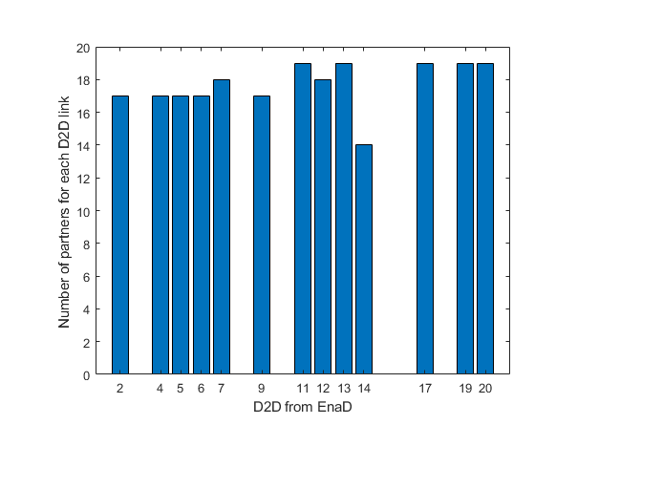
But it is noted that for each D2D link i, it will have more than one CUE partner k.....

Slide 17
Target: Help each D2D link find it best partner CUE to maximize its Energy Efficiency
IiI want my CUE partner to help me achieve maximum EE!!
CUE
D2D

Slide 18

EE definition [2]
$EH_{i}^{D}=\left\{\begin{aligned}0, \\ k_{j}P_{i}^{R}+b_{j}, \\ P_{max}^{harvested},\end{aligned}\right.\begin{matrix} P_{i}^{R}∈[P_{thresold}^{0},P_{thresold}^{1}] \\ P_{i}^{R}∈[P_{thresold}^{j},P_{thresold}^{j+1}] \\ P_{i}^{R}∈[P_{thresold}^{L},P_{thresold}^{L+1}]\end{matrix}$
$P_{i}^{R}=θ_{i}\left(P_{i}^{D}h_{i}^{D}+P_{k}^{c}h_{k,i}+N_{0}\right)$
EE=$\frac{T_{i}^{D}}{EC_{i}^{D}}=$ $\frac{log2\left(1+\frac{\left(1−θ_{i }\right)P_{i}^{D}h_{i}^{D}}{\left(1−θ_{i}\right)\left(P_{k}^{c}h_{k,i}+N_{0} \right)+N_{1}}\right)}{P_{i}^{D}+2P_{circuit}−EH_{i}^{D} }$

Slide 19

Formulation of each D2D link’s EE maximization problem [3]
$C1:\max_{θ_{i},P_{i}^{D}, i∈EnaD}{EE_{i}^{D}}$
$\begin{matrix}N1: \\ N2: \\ N3:\end{matrix}\begin{matrix} 0<P_{i}^{D}<P_{max} \\ 0≤θ_{i}≤1 \\ T_{i}^{D}≥T_{min}^{D}\end{matrix}$
$\begin{matrix}N4: \\ N5: \\ N6:\end{matrix}\begin{matrix}T_{k}^{C}≥T_{min}^{C} \\ P_{i}^{R}≥P_{thresold}^{1} \\ { P}_{thresold}^{j}≤P_{i}^{R}≤P_{thresold}^{j+1}\end{matrix}$
$C2:\max_{θ_{i},P_{i}^{D},i∈EnaD}{T_{i}^{D}−G_{i}^{D}EC_{i}^{D}}$
s.t. $N1−N6$

Slide 20

Lagrange function and Lagrange multipliers [1]
$L(P_{i}^{D},θ_{i},α,β,γ,δ,σ) =T_{i}^{D}−G_{i}^{D}EC_{i}^{D}−α\left(P_{i}^{D}−P_{max}\right)−β\left(θ_{i}−1\right)+γ\left(T_{i}^{D}−T_{min}^{D}\right) +δ\left(T_{i}^{C}−T_{min}^{C}\right)+σ(P_{i}^{R}−P_{thresold }^{1})$
$\begin{matrix} α={\left\{α+s_{1}\left(P_{i}^{D}−P_{max}\right)\right\}}^{+} \\ β={\left\{β+s_{2}\left(θ_{i}−1 \right)\right\}}^{+} \\ γ={\left\{γ+s_{3}\left(T_{i}^{D}−T_{min}^{D}\right)\right\}}^{+} \\ δ={\left\{δ+s_{4}\left(T_{i}^{C}−T_{min}^{C}\right)\right\}}^{+} \\ σ={\left\{σ+s_{5}\left(P_{i}^{R}−P_{thresold }^{1}\right)\right\}}^{+}\end{matrix}$

Slide 21
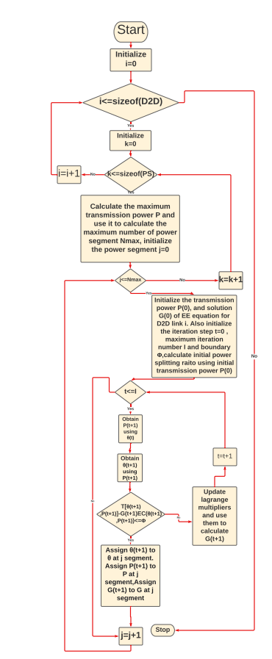
Inner Loop

Slide 22
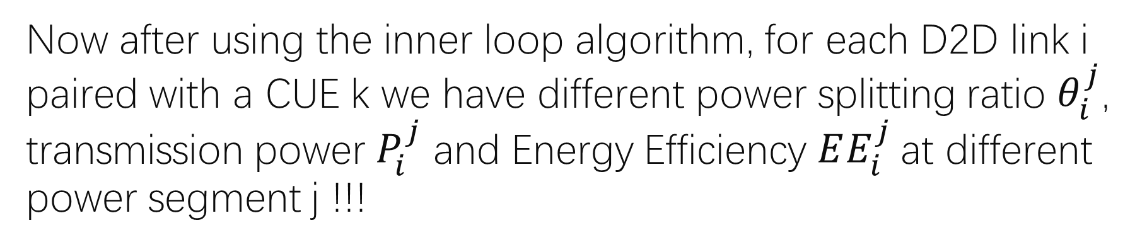
Now after using the inner loop algorithm, for each D2D link i paired with a CUE k we have different power splitting ratio $θ_{i}^{j}$, transmission power $P_{i}^{j}$ and Energy Efficiency $EE_{i}^{j}$at different power segment j !!!
D2D link i
CUE k
Power segment j

Slide 23
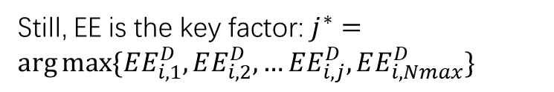
Now we need to find the best power segment for each so that we can find the best partner for each D2D link i
Still, EE is the key factor: $j^{∗}=\arg{max⁡\{EE_{i,1}^{D},EE_{i,2}^{D},…EE_{i,j}^{D},EE_{i,Nmax}^{D}\}}$

Slide 24
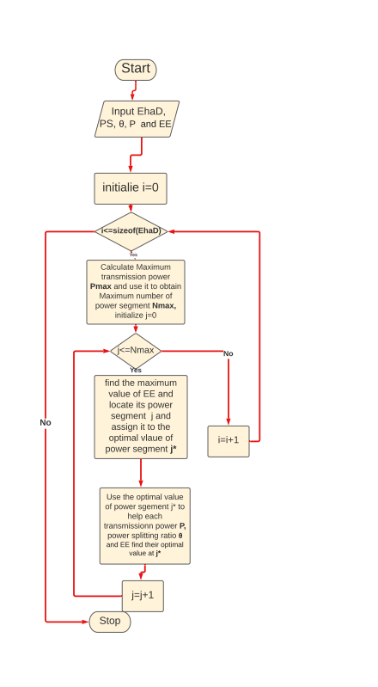
Outer Loop
ALGORITHM 3: OUTER LOOP ALGORITHM

Slide 25
Good!! Now we have the best power segment for each D2D link i paired with a CUE k.
Optimal power segment j*
D2D link i
CUE k

Slide 26

Now since each D2D i paired with CUE k has its best power segment, we can then find i’s best partner..
I want my CUE partner to help me find the maximum EE!!
Well, I want my partner to have the least interference power from me!!!!
CUE k
D2D link i

Slide 27

Interference power [1]
$P_{interference}=P_{i}^{D}h_{i}^{B}$

Slide 28
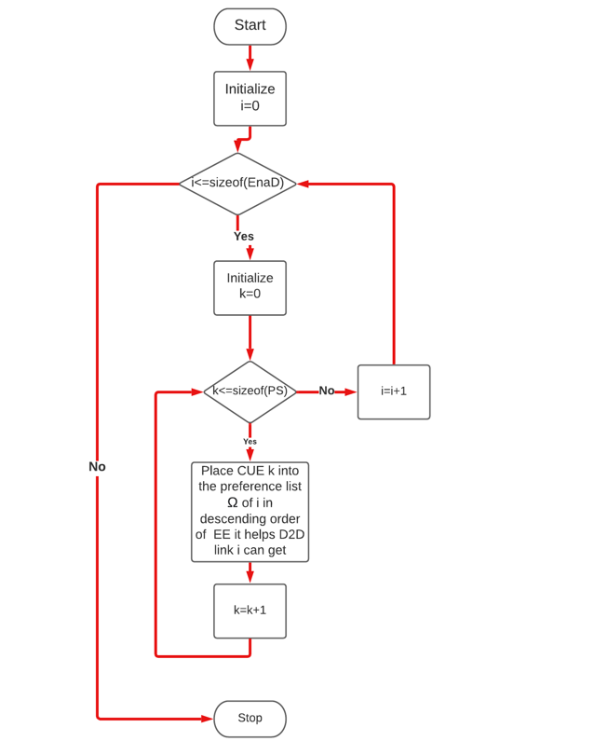
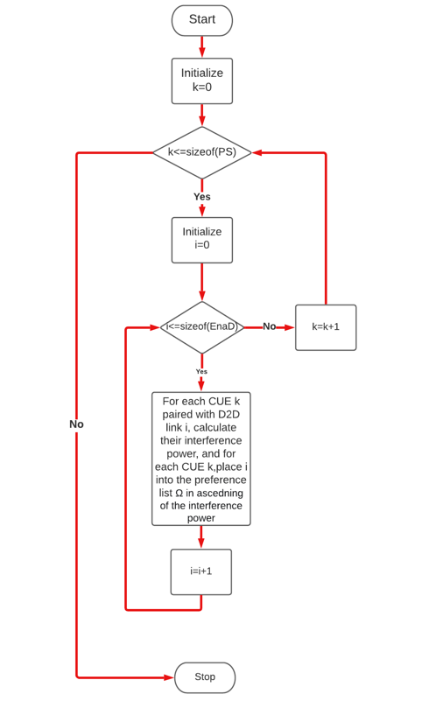
Preference list
List for each D2D link i
List for each CUE k

Slide 29
After building the preference list....
D2D link i
CUE k
CUE 1
CUE2
CUE3
D2D 1
D2D2
D2D3
They were all placed in descending order of EE
They were all placed in ascending order of Interference power

Slide 30
Now we want to find the each D2D link i’s best partner CUE k
D2D link i
CUE k
D2D 1
D2D2
D2D3
CUE 1
CUE 2
CUE 3

Slide 31
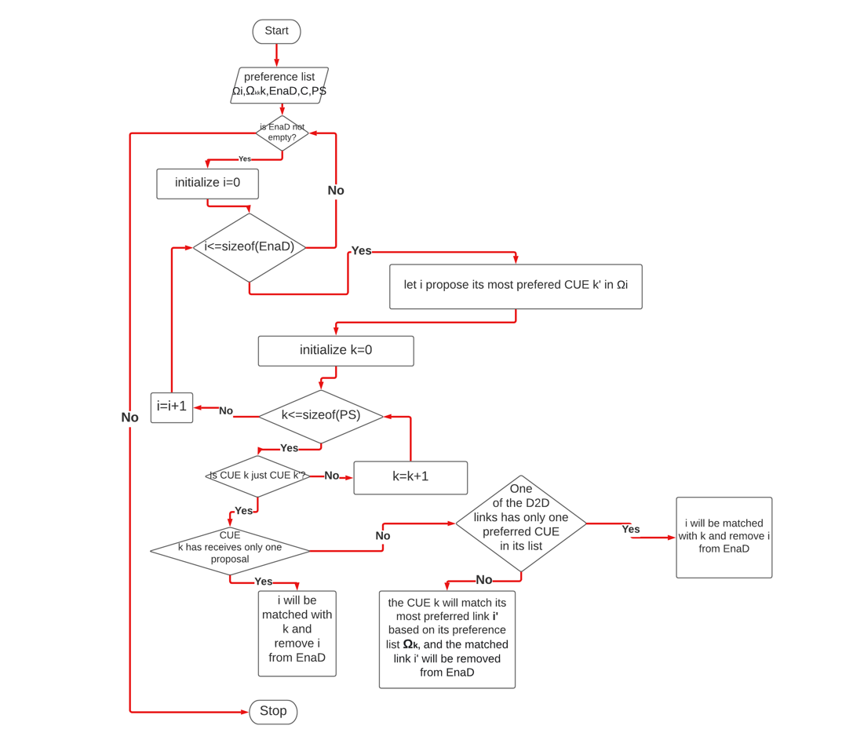
One to one stable Matching

Slide 32
After using one-to-one stable matching, each D2D link i will find its best partner CUE k which can help it obtain the maximum EE.
D2D link i
CUE k

Slide 33
Result
Pre-Matching Failure Rate (PFMR)
Convergence of Inner Algorithm
Sum EE under different circumstances

Slide 34

Pre-Matching Failure Rate(PMFR)
$PMFR=\frac{number of D2D links in InfD}{total number of D2D links}$

Slide 35
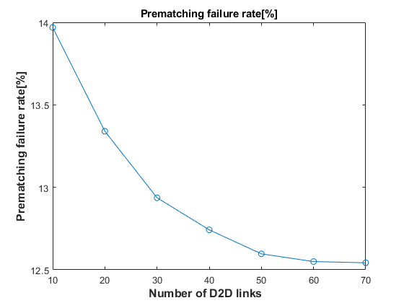
Pre-Matching Failure Rate for different number of D2D links
Fig. 1 Pre-matching failure rate versus the number of D2D links

Slide 36
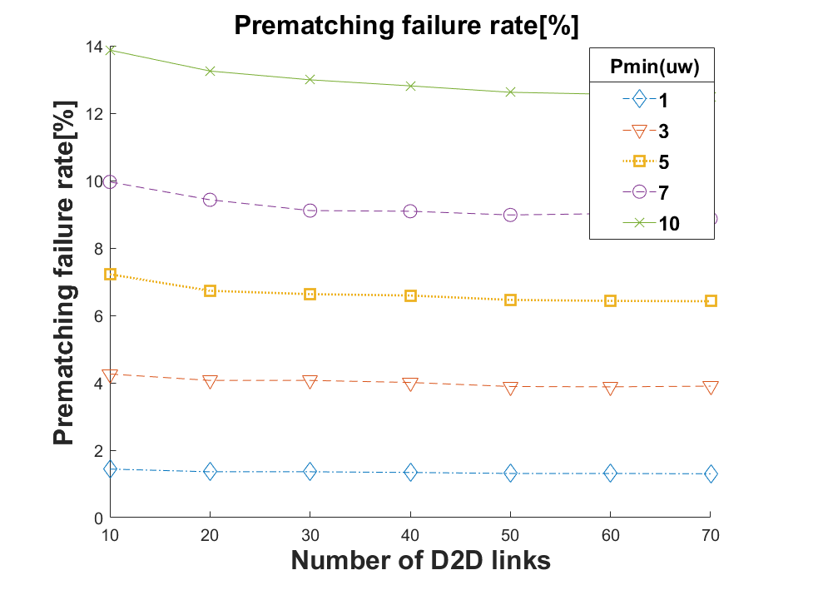
Pre-Matching Failure Rate for different number of D2D links with different threshold power limit
Fig. 2 Pre-matching failure rate with different minimum power segment at different D2D users

Slide 37
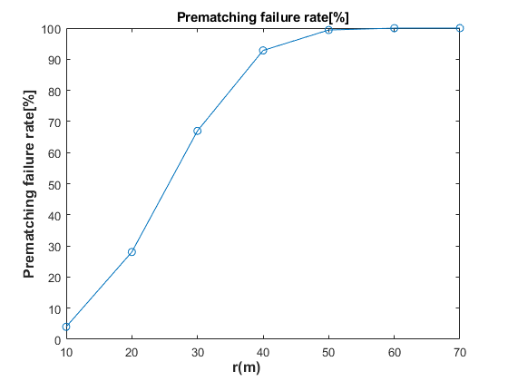
Pre-Matching Failure Rate for different communication distance
Fig. 3 Pre-matching failure rate versus D2D communication distance.

Slide 38
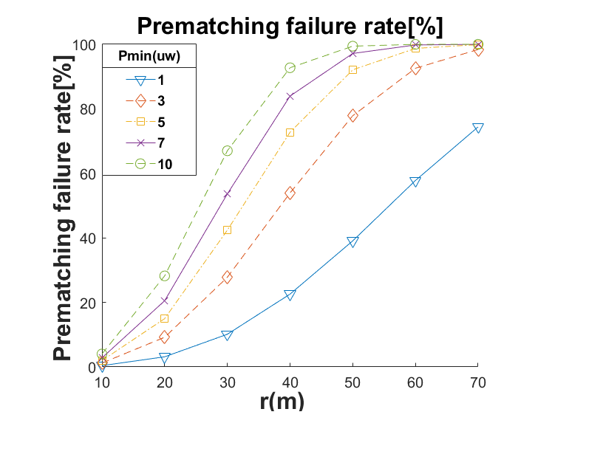
Pre-Matching Failure Rate for different communication distance with different threshold power limit
Fig. 4 Pre-matching failure rate with different minimum power segment at different D2D communication distance

Slide 39
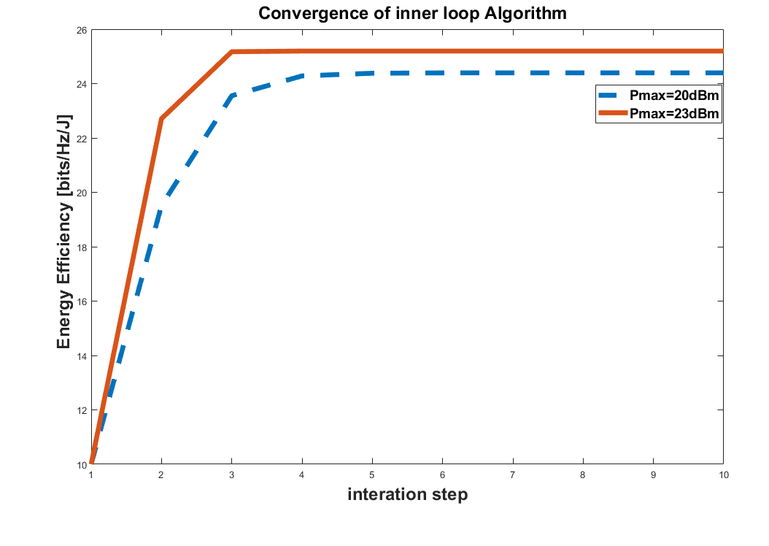
Convergence of inner Algorithm
Fig. 5 Convergence of inner loop algorithm

Slide 40
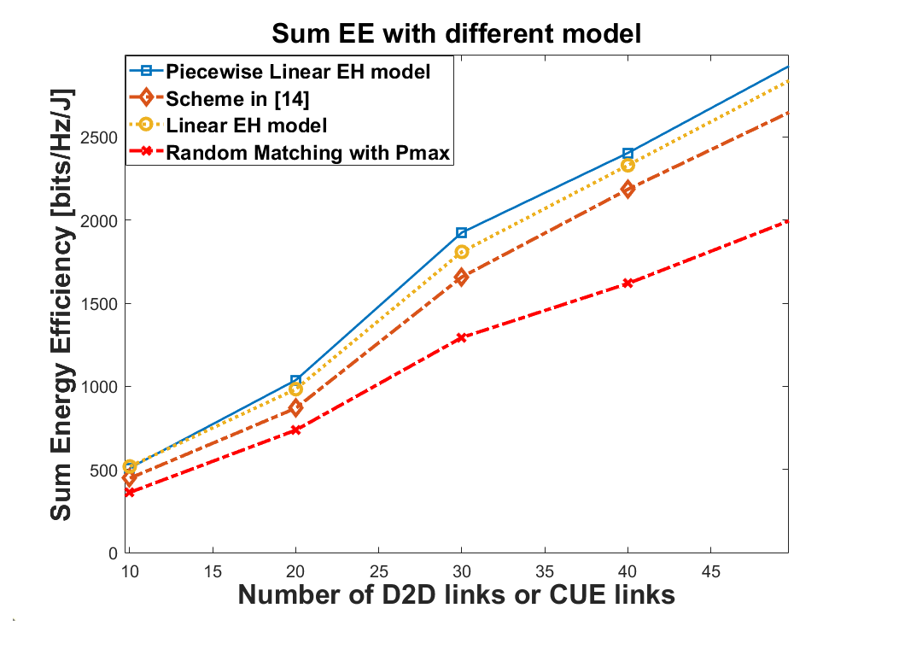
Sum EE versus different number of Users
Fig. 6 Sum EE at different number of D2D links or CUEs

Slide 41
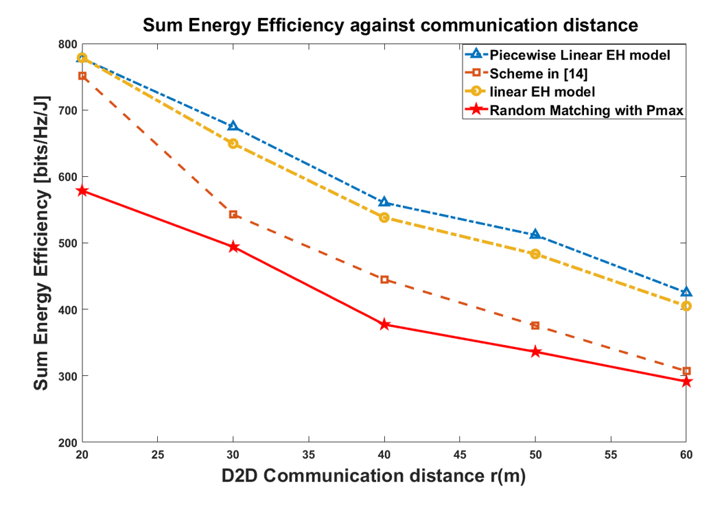
Sum EE versus communication distance
Fig. 7 Sum EE at different communication distance

Slide 42
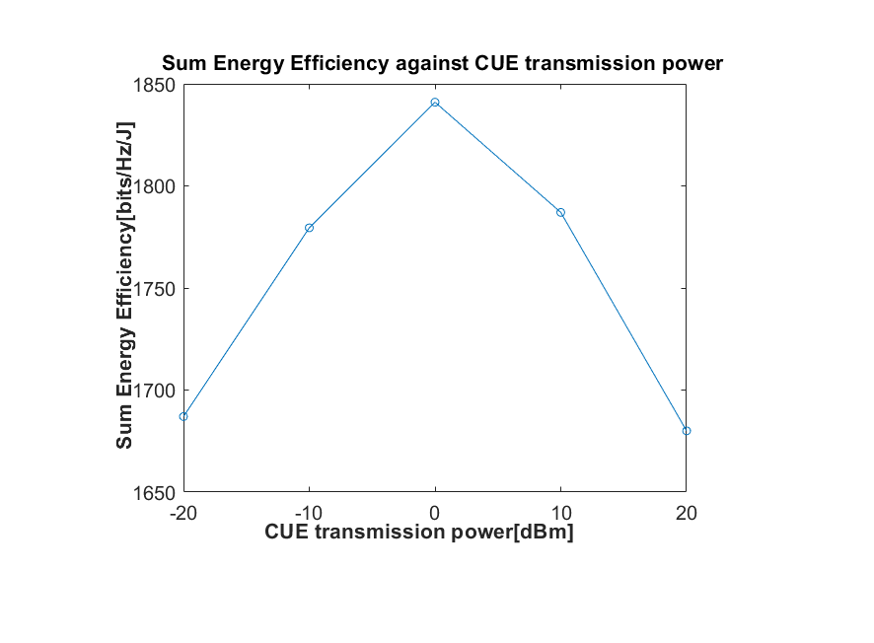
Sum EE versus communication distance

Slide 43
Summary
1. The algorithms are all implemented following the derivations in [1]
2. The results give the expected EE performance and prove to be more energy efficient than the existing work

Slide 44

Future Plan
1. Optimization of complexity of the inner loop Algorithm
2.Further optimization of the CUE transmission power, power splitting ratio and transmission power of each D2D link $i.$

Slide 45
Reference
[1]. Yang. H, Ye. Y, Chu. X and Dong. M, “Resource and Power Allocation in SWIPT-Enabled Device-to-Device Communications Based on a Nonlinear Energy Harvesting Model,” IEEE Internet of Things Journal., vol. 7, no.11, pp.10813-10825, Nov. 2020.
[2].M. Zhao, Q. Shi, and M. Zhao, “Efficiency maximization for UAV-enabled mobile relaying systems with laser charging,” IEEE Trans. Wireless Commun., early access, Feb. 12, 2020, doi: 10.1109/TWC.2020.2971987.
[3]. W.Dinkelbach,“On nonlinear fractional programming,” Manag. Sci., vol. 13, no. 7, pp. 492–498, Mar. 1967.d

Slide 46
Thanks for listening!!
此照片，作者: 未知作者，许可证: CC BY-SA

Slide 47

Q&A Session

